Slide 1
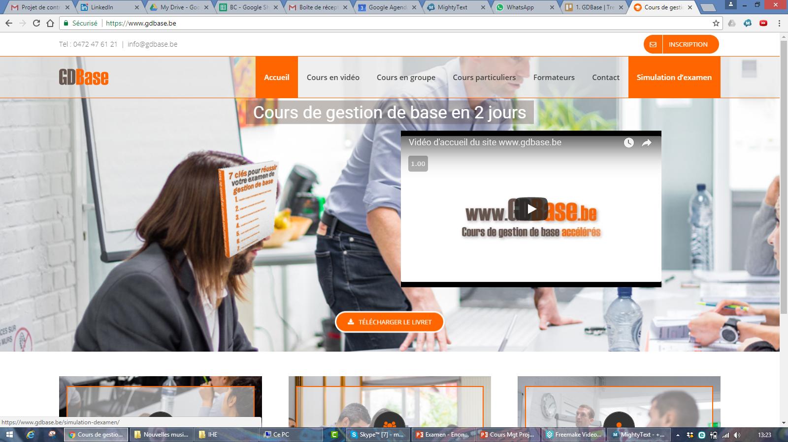

Slide 2
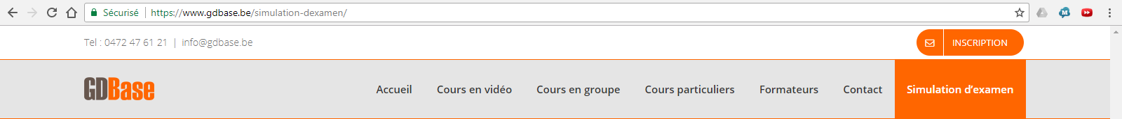
Simulation 1 - Free
Simulation 4
Simulation 2
Simulation 5
Simulation 3
Simulation 6

Slide 3
Payement interface
Simulation 2 : 20€
Simulation 1 - Free
Simulation 4
First name and last name
Simulation 2
Card number
Simulation 5
Month
Year
Cryptogram
Pay
Simulation 3
Simulation 6

Slide 4
Simulation 1
Question 1 : XXXXXXXXXXXXXXXXXXXXXXXXXXXXXXXXXXXXXXXXXXXXXXXXX
Answer 1 : AAA
Answer 2 : BBB
Answer 1 : CCC
Answer 2 : DDD
Next question

Slide 5
Simulation 1
Question 2 : YYYYYYYYYYYYYYYYYYYYYYYYYYYYYYYYY
Answer 1 : AAA
Answer 2 : BBB
Answer 1 : CCC
Answer 2 : DDD
Previous question
Next question

Slide 6
Simulation 1
Question 30 : ZZZZZZZZZZZZZZZZ
Answer 1 : AAA
Answer 2 : BBB
Answer 1 : CCC
Answer 2 : DDD
Previous question
Validate your exam

Slide 7
Exam passed !
64,3%
Congratulation, you seem ready to pass the real exam
If you want to be sure to pass it, enjoy our 100 corected exam question.
Get the 100 exam questions

Slide 8
Payement interface
100 exam questions : 100€
Simulation 4
Exam passed !
64,3%
First name and last name
Card number
Simulation 5
Congratulation, you seem ready to pass the real exam
If you want to be sure to pass it, enjoy our 100 corected exam question.
Month
Year
Cryptogram
Pay
Get the 100 exam questions

